Slide 1
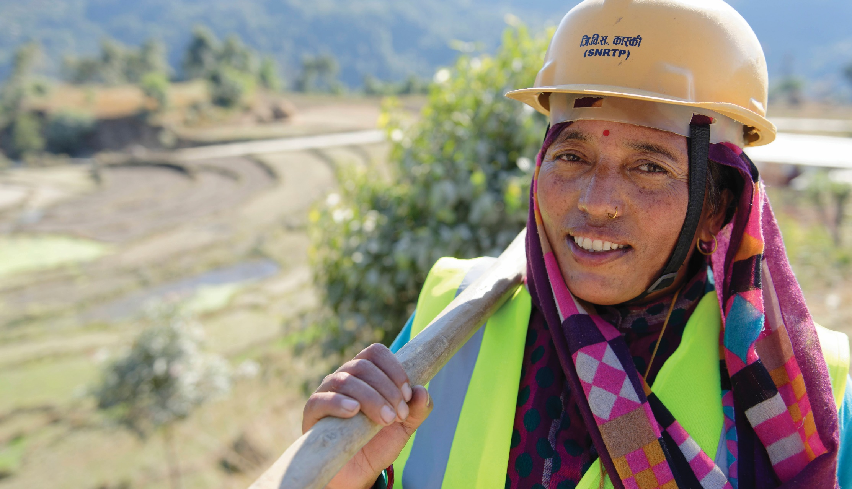
The ILO
Global Business Network on
Forced Labour
Notes:
INTRODUCTION
Dear speaker,
This presentation is provided by the ILO GBNFL secretariat to members and partners. The aims of the presentation are to:
Introduce the network
Raise awareness of forced labour
Recruit new members and partners.
The presentation in full, making use of all the speaking notes and showing the video on slide 6, should take around 15 minutes.
Please feel free to amend this presentation to suit your audience.
To show the video on slide 6 you need to be connected to the internet.
Please consider sharing membership and partnership brochures with your audience. These can be found here https://flbusiness.network/join/
If you have any questions or would like further information, please contact fl-businessnetwork@ilo.org
START OF SPEAKING NOTES
There are an estimated 27.6 million people in forced labour globally. Our business network is determined to stop it.
ILO GBNFL brings together businesses of all sizes and sectors, and their networks, from around the globe to eradicate forced labour. Operating across all sectors and geographies, network members and partners work to engage smaller enterprises. We develop resources and tools and devise local solutions that help shape national frameworks to create lasting change.
(Please introduce yourself and explain how you are affiliated with ILO GBNFL).

Slide 2
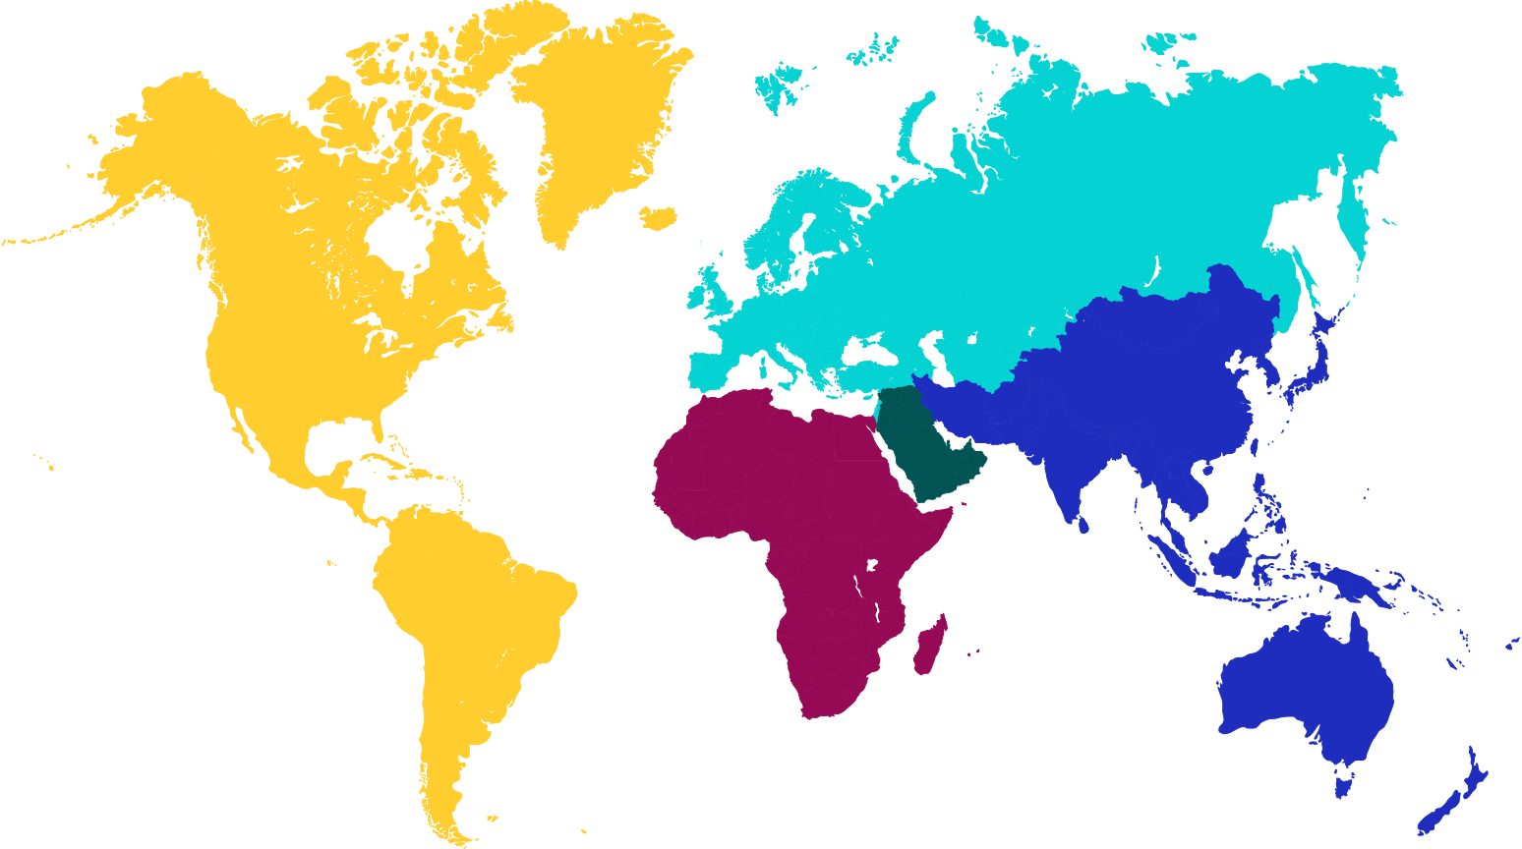
The Challenge: Global Facts & Figures
4.1 million
    Where does forced labour happen?
3.6 million
0.9 million
15.1 million
3.8 million
flbusiness.network
Notes:
Forced labour happens in every region – no place is immune.
More than half of all those in forced labour worldwide are in the Asia and the Pacific region. The rest is distributed between Africa (3.8 million), Europe and Central Asia (4.1 million), the Americas (3.6 million) and the Arab States (0.9 million).
More than half of all forced labour occurs in upper-middle or high-income countries. Lower-middle income countries account for 32% and low-income countries for 16% of all forced labour.

Slide 3
The Challenge: Global Facts & Figures
Forced labour has increased
    What are the current trends?
by 2.7 million people since 2016.
The number of people trapped in forced labour is increasing.
This is entirely due to an increase of victims in the private economy.
Companies can play a vital role in eradication.
Notes:
Current trends indicate that things are worsening.
Between 2016 and 2021 forced labour increased from 24.9 to 27.6 million people.
The increase in forced labour since 2016 is entirely due to the higher number of victims in the private economy, so businesses have a key role to play in eradicating it.
What’s more, some of the data used for the most recent estimates dates from before the COVID-19 pandemic. COVID has exacerbated the root causes of forced labour, such as poverty and discrimination. Therefore, the figures we are sharing with you are likely to underestimate the total number of victims.

Slide 4
Current challenges for the private sector
Achieving visibility to lower tiers of supply chain (as well as leverage to influence change)
Fair recruitment (including repayment of recruitment fees and related costs)
Internal awareness, capacity building, and buy-in
Navigating changing government regulations
State-sponsored forced labour
Notes:
This slides some of the current challenges reported by companies on eradicating forced labour.

Slide 5
Current solutions:
Increased focus on due diligence as well as reporting
Work on service agreements with recruitment agencies (promoting direct recruitment)
Repayment of recruitment fees and related costs (remediation efforts)
Publishing of remediation efforts
Varying progress in different sectors
Worker voice technologies
Working through industry initiatives
Engaging with stakeholders to understand the issues and the root causes
Notes:
These are some of the current topics and solutions the private sector is focussing on to eradicate forced labour.

Slide 6




Our Mission
To drive action, scale and sustainability through collaboration
Connect
Convene
Innovate
Support
Notes:
So what is our role when it comes to forced labour? How can the network help?
Our network aims to drive action on forced labour, to scale it up, and ensure it is sustainable. We do this by working together.
Our key focus areas are:
CONNECT
Break silos by linking up business actors from across sectors and geographies to eradicate forced labour.
CONVENE
Support businesses to engage with other relevant stakeholders, including government bodies, to find sustainable solutions to the structural drivers of forced labour.
INNOVATE
Create spaces where businesses identify gaps, develop new ways of tackling forced labour, and devise methods to scale up solutions.
SUPPORT
Share user-friendly and action-oriented data, information and resources to help busy businesses take steps to tackle forced labour.

Slide 7
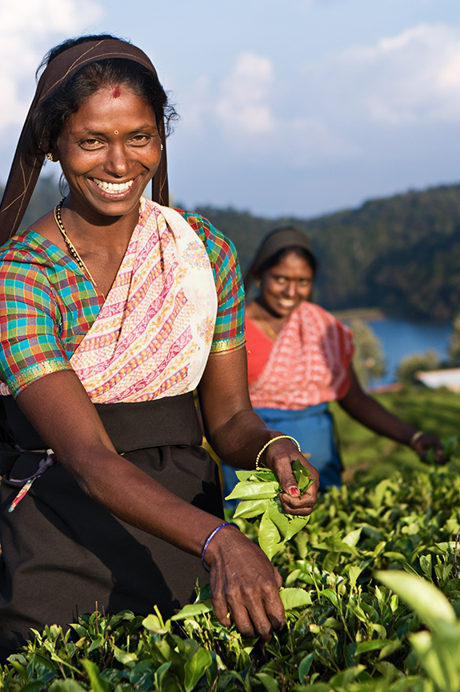
Our members and partners
    Take concrete steps to eradicate forced labour
    Advocate for a comprehensive and coordinated response to forced labour
    Uphold the principles of inclusivity and collaboration
Notes:
Our members are businesses of all sizes and sectors, employer and business membership organizations, industry trade groups and sectoral associations.
Other business-led initiatives with complementary mandates and expertise are encouraged to join as partners.
All network members and partners:
Take concrete steps to eradicate forced labour in all its forms in their organizations, supply chains, member organizations, sectors and beyond
Advocate for a comprehensive and coordinated response to eradicate forced labour, including in dealings with government bodies
Uphold the principles of inclusivity and collaboration when working with other stakeholders to end forced labour.

Slide 8


















Members & Partners
Members
Partners
Companies
Apple Inc
The Coca-Cola Company
Business networks
Notes:
We have a strong, dedicated and growing membership. Together, we advocate for an end to forced labour through events, activities, meetings with decision makers, social media… the list goes on.
In practical terms this includes launching the first global award for SME (small- and medium-sized enterprises) action on forced labour, training sessions for businesses and their representative organizations, a training manual on fair recruitment, three podcast series, advocacy papers shared with decision-makers, and much, much more.

Slide 9

Companies and their representative organizations are fighting forced labour.
Join us and access the skills, knowledge and resources to make a difference.
Notes:
If you work for a business or employer/business membership organization, then join us and help end forced labour.
In addition to doing what is right, you will:
Receive official recognition for measured contributions to the Sustainable Development Goals
Gain visibility through ILO, UN, and network communications and activities
Tap into the ILO’s convening power among governments, workers, and employers
Draw on the expertise and experience of leading industry initiatives, global brands and the ILO
Receive advice and support from the ILO GBNFL secretariat
Partner with the ILO in technical work, delivering solutions on the ground.
On our website you can find more information for prospective members in English, French and Spanish https://flbusiness.network/membership/

Slide 10
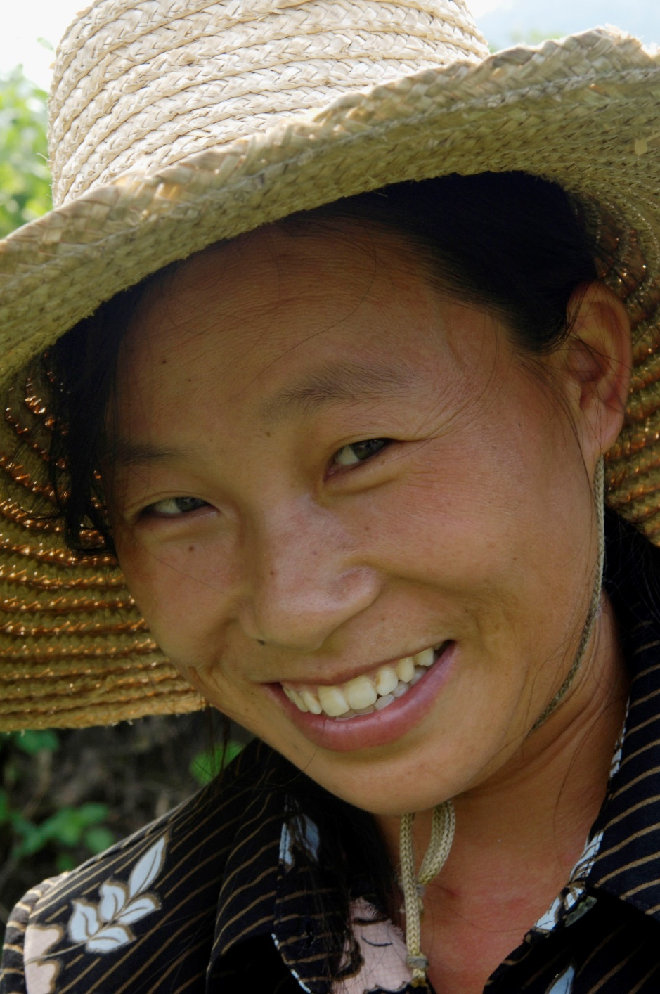
ILO GBNFL tools
Online webinar training on ILO’s 11 indicators of forced labour
Eradicating forced labour: What works in practice?
Fair recruitment due diligence training for SMEs
Visit: https://flbusiness.network/library-publication/ for an overview of available resources
Notes:
We have freely available tools and resources on our website both from the ILO and other stakeholders. This slides details a few that the ILO GBNFL has developed for companies.

Slide 11
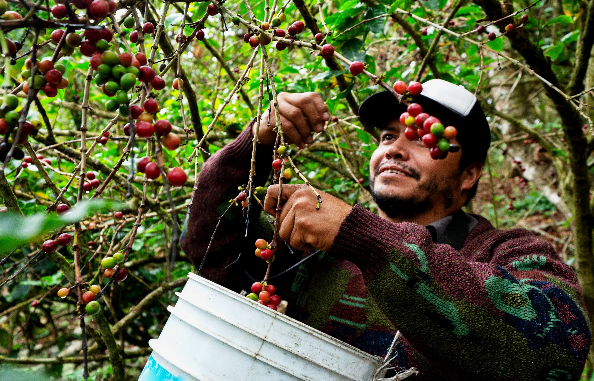




Stay in touch!
flbusiness.network
fl-businessnetwork@ilo.org
@ILOFLNetwork
ILO Global Business Network on Forced Labour
Notes:
Thank you for your time.
More information can be found on our website, where you can also sign up to join the network, receive our newsletter, find tools and resources, information on our latest activities, and more. You can also follow us on Twitter and connect with us on Linked-In.
And, if you would like to discuss further, please come and find me or get in touch, either with me or with our secretariat.

